Slide 1
TELECOMMUNICATION CHURN PREDICTION
IDS 561 – Analytics for Big Data
Fall 2022
GROUP 9
Aditya Naigaonkar: (UIN: 671279933)
Jitesh Patil: (UIN: 653037840)
Nirmal Tanjorkar: (UIN: 665035319)
Vidhit Tambe: (UIN: 651729186)

Slide 2
WHAT IS CHURN RATE?
Churn rate, sometimes referred to as attrition rate, is the frequency with which consumers discontinue doing business with a company over an extended period of time.
STATISTICS:
Annual average churn rate: 10%-67%
Having better plans would have prevented 40% of customers from switching.
79% of customers acknowledged venting to others about how dissatisfied they were with the telco's level of service.

Slide 3
PROBLEM STATEMENT Based on their utilization of the service, predicting which customers are most likely to cancel a subscription, or "leave a company."
OBJECTIVE
Predicting customer churn aims to locate departing clients for a telecommunications service provider in advance. The telecom service provider could plan their client retention strategy with the help of a customer churn forecast. With the deployment of data mining tools, the industry's large volume of data becomes the key resource for forecasting customer attrition.
DATASET
The Telco Customer Churn dataset is what we are using. It has 7043 rows, and each row corresponds to a customer. Each customer has 21 traits or attributes (columns). On Kaggle, this dataset is accessible.

Slide 4
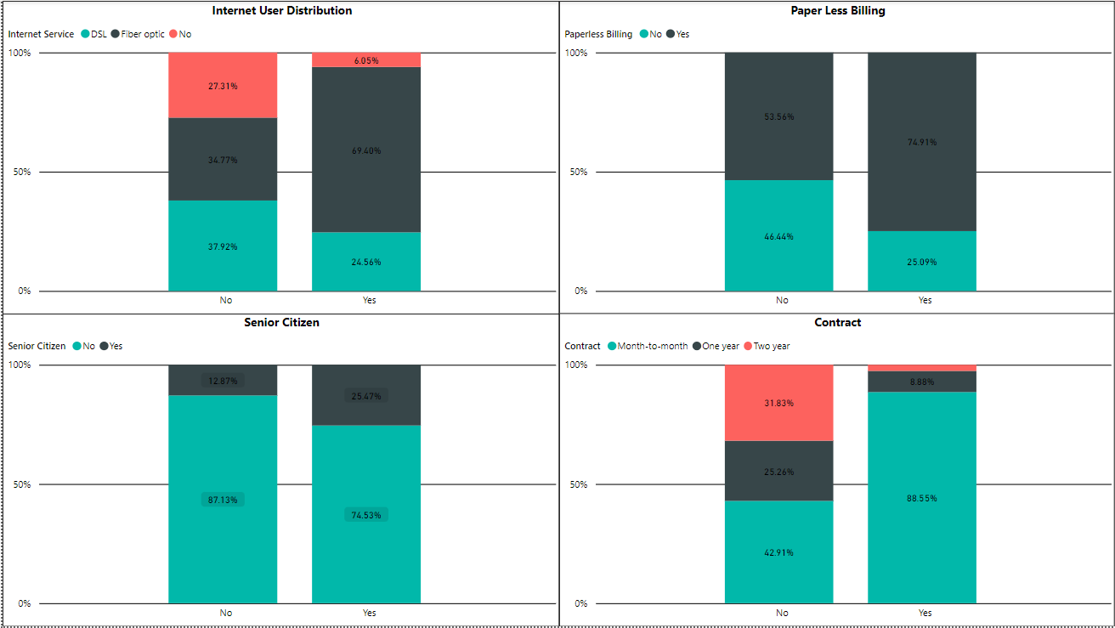
DATA VISUALIZATION ON RAW DATA

Slide 5
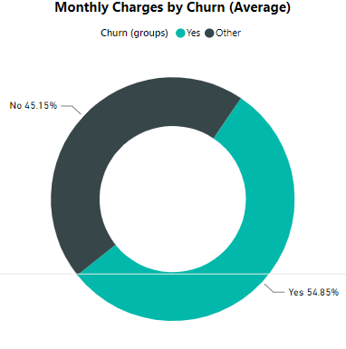
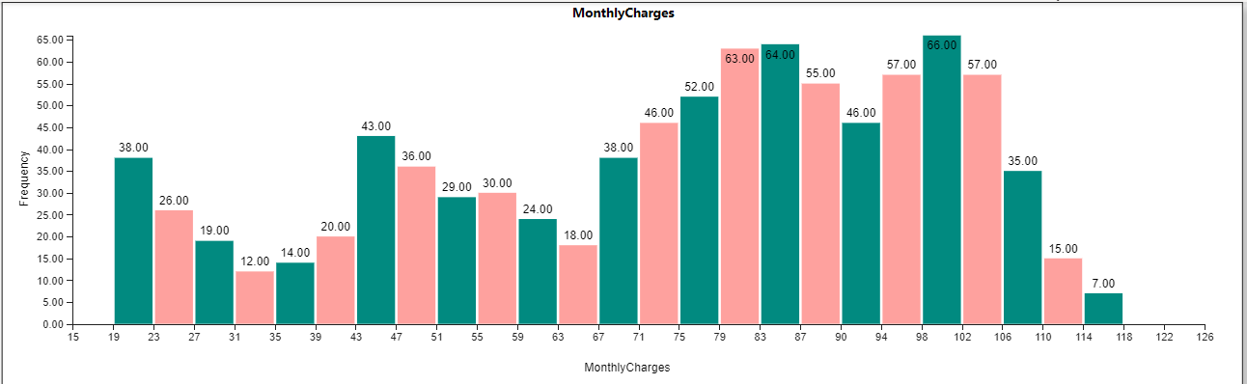
DATA VISUALIZATION ON RAW DATA

Slide 6
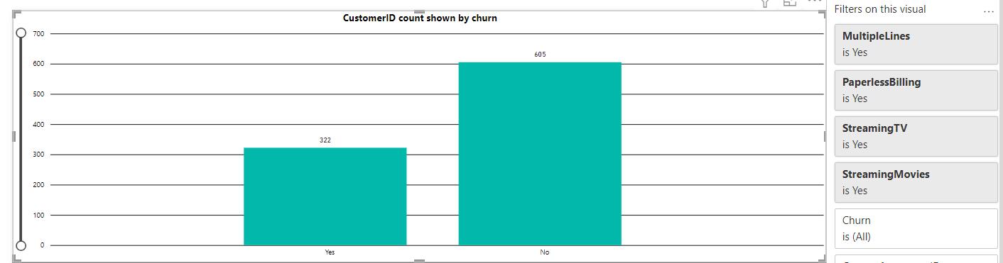
DATA VISUALIZATION ON RAW DATA
﻿﻿Count of customerID for No 605 was higher than Yes 322.﻿
﻿No. accounted for 65.26% of the Count of customerID.﻿
﻿No. had 605 Count of customerID and Yes had 322.﻿

Slide 7
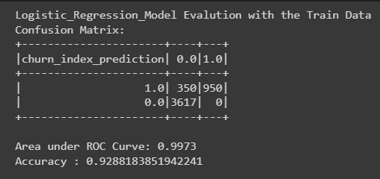
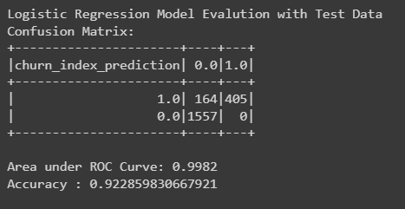
BEST MODEL AND RESULTS
The Machine learning algorithms used to build models are:-
Logistic Regression Model
Naïve Bayes Model
Logistic Regression Model using pyspark

Slide 8
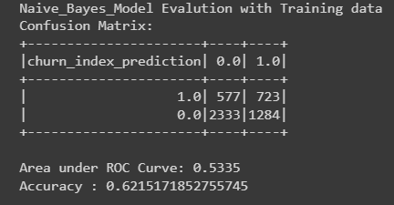
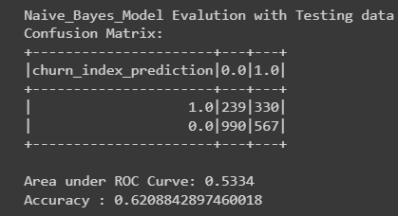
BEST MODEL AND RESULTS
Naïve Bayes Model using pyspark

Slide 9
RESULTS
FINAL RESULTS BASED ON PREDICTION MODELS:
The logistic regression model has a similar area under the true positive vs. false positive ROC curve of ~99.00 % and a training and testing accuracy of ~93%.
The regularization parameter in use is to blame for this. A good model fit is implied by the same train/test accuracies and AUC.
The multinomial naive Bayes model yields a training and testing accuracy of ~62%; the similarity between the two values suggests a strong model fit. ROC curves have training and testing AUCs of ~53% each.
FINAL RESULTS BASED ON DATA VISUALIZATIONS
By offering customers a long-term contract of 2 years, the customer churn rate can be reduced.
People with very high or very low tenure and senior citizens are leaving the service. The company should introduce new plans and services to senior citizens to reduce the churn rate.
There is no problem with monthly pricing or the manner of payment, but most clients cannot afford a two-year subscription, so the business needs to produce new offers and schemes.

Slide 10
Thank You.

